Slide 1
The New Modern Application Platform Session 8: Kubernetes Operations
“Bridging the growing chasm between developers and infra engineering”
Andy Tauber, Staff TAM
Dave Mazur, Staff TAM
January 2021

Slide 2
Today’s Class
K8s Operations Overview
Guest Presenter – Dan Linsley
Container Sizing and Memory
Service Level Objectives
Autoscaling Concepts
Logging
Fluentd
ElasticSearch
Kibana
Log Insight
Operations Metrics
cAdvisor and vROPs
Prometheus
Grafana

Slide 3
Container Sizing and Resource Management placeholder
We

Slide 4
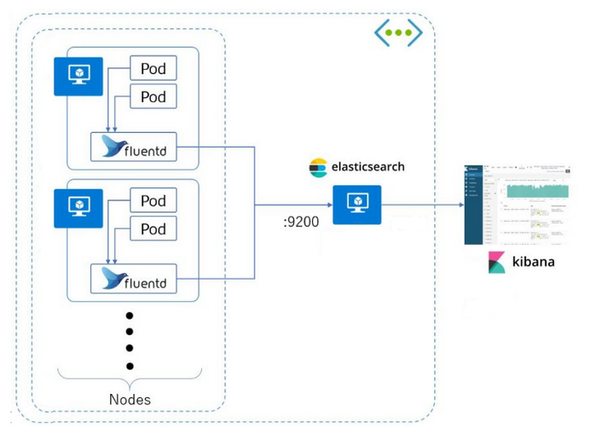
K8s Logging
You will commonly see “EFK” or “ELK” used
EFK – Elasticsearch, Fluentd or FileBeat, Kibana
ELK – Elasticsearch, Logstash, Kibana
Collects the same pod logs you see when you do a:
kubectl logs <podname> <containername>
Logs are found on each K8s node at:
/var/log/containers/*.log
Notes:
Code borrowed from: https://www.digitalocean.com/community/tutorials/how-to-set-up-an-elasticsearch-fluentd-and-kibana-efk-logging-stack-on-kubernetes
Demo EFK stack

Slide 5
K8s Logging to VMware
Logs can be sent to Log Insight and/or Wavefront
The open source solutions have a number of potential issues:
Support – no one to help when there is an issue
Guidance – a lack of guidance on how to install or configure for an Enterprise grade deployment
Federation of tools
Backups and resiliency
A tendency by developers to install logging and ops tools within the same clusters they are monitoring – a single point of failure
Good resources for Fluentd logging to Log Insight. Log Insight can not ”read” K8s native logs but Fluentd does come with a Log Insight plugin to help:
https://vmguru.com/2020/07/gain-insight-in-kubernetes/
https://github.com/ddeswart/fluentd-log-collector/blob/master/k8s-log-collector-ds.yaml
Wavefront uses a telegraf agent (sidecar) to send log information.

Slide 6
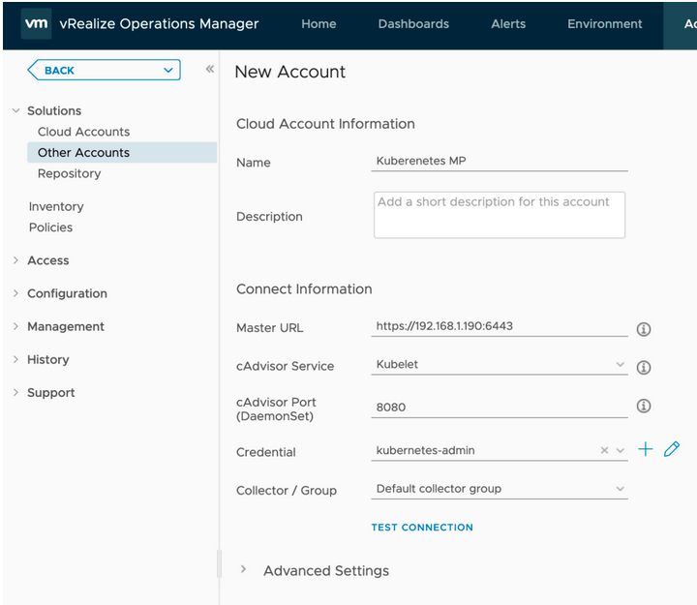
Sending Metrics to vROPs
Metrics can come from: cAdvisor or Prometheus
The Credential is an access certificate, similar to what you use with kubectl
Be very careful with what version of MP you use depending on vROPs version and K8s version
cAdvisor (Container Advisor) provides container users an understanding of the resource usage and performance characteristics of their running containers. It is a running daemon that collects, aggregates, processes, and exports information about running containers.
Notes:
Demo cAdvisor install and metrics
https://docs.vmware.com/en/Management-Packs-for-vRealize-Operations-Manager/1.4.3/container-monitoring/GUID-13C06790-C129-4547-B81C-FDCA2BEB29BC.html
https://github.com/google/cadvisor

Slide 7
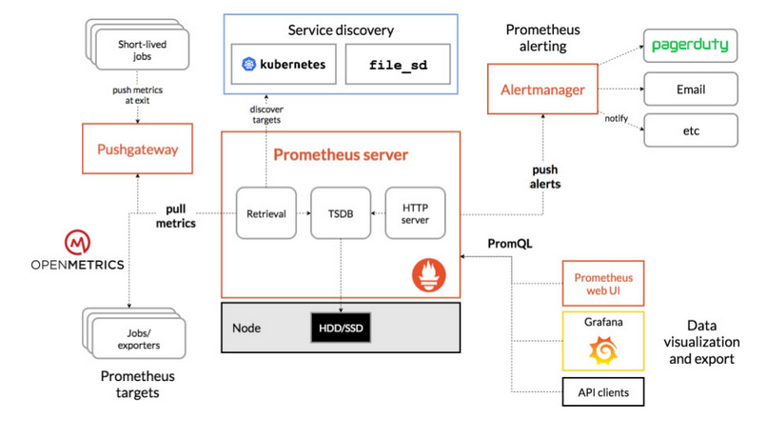
Prometheus and Grafana
This is by far the most common solution you will find your developers using
Notes:
Demo Prometheus and Grafana
Kube-Prometheus: https://github.com/prometheus-operator/kube-prometheus
Community built dashboards: https://grafana.com/grafana/dashboards?plcmt=footer

